Slide 1
Star commanders
Augmented reality card game

Slide 2
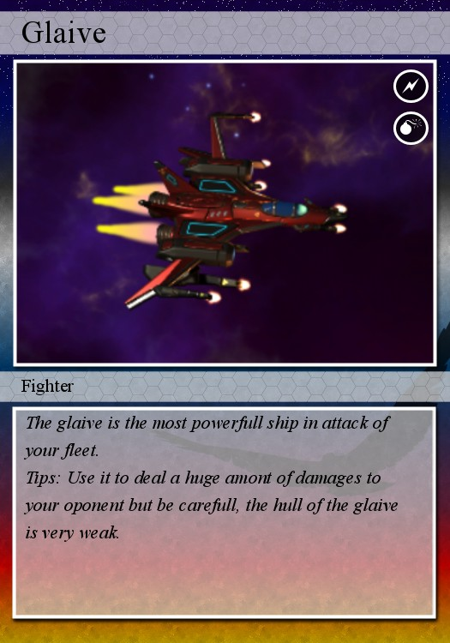
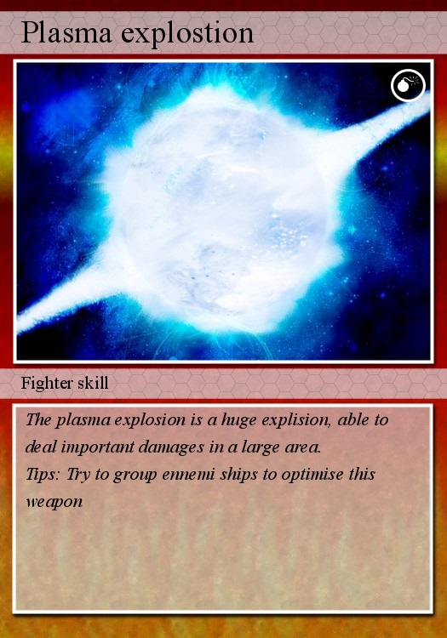
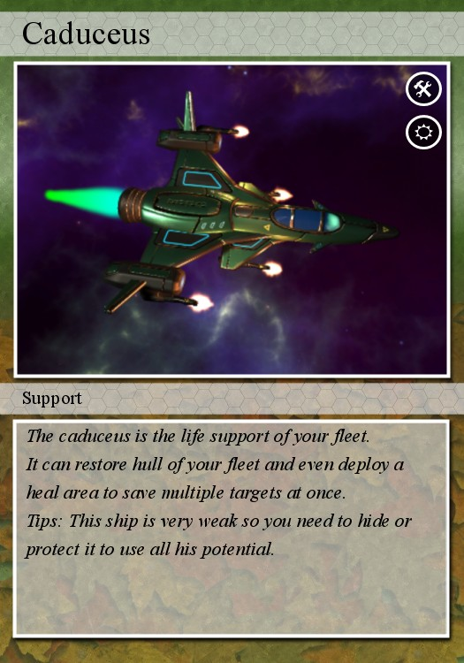
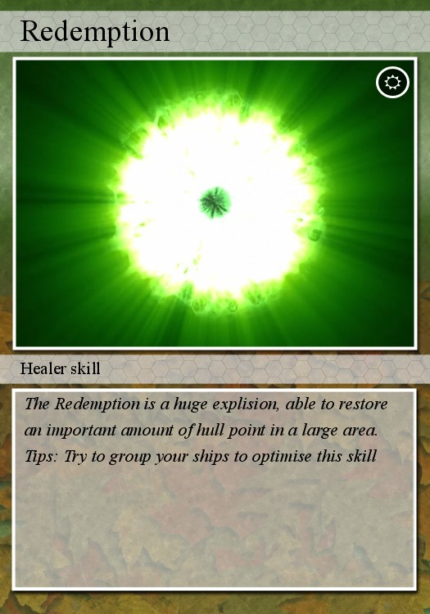
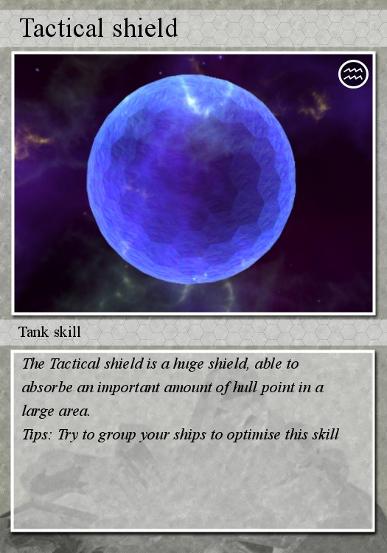
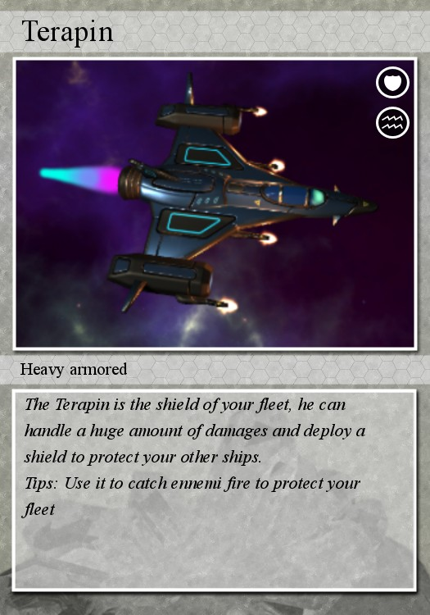
Play with cards
1v1 match
Manage your fleet
Use powerful abilities to defeat your opponents
Collect cards to upgrade your fleet

Slide 3
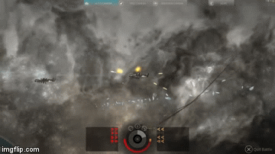
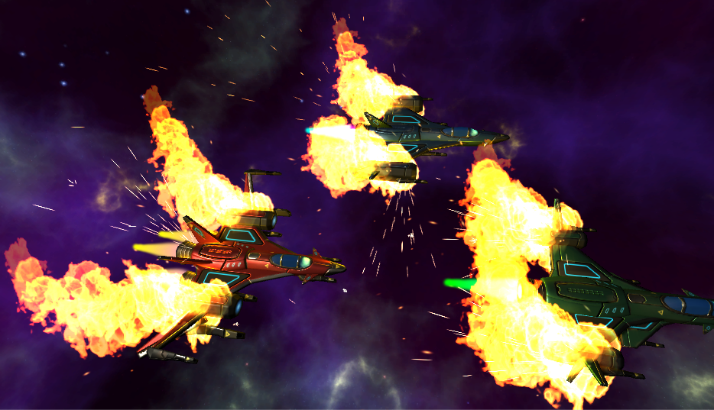
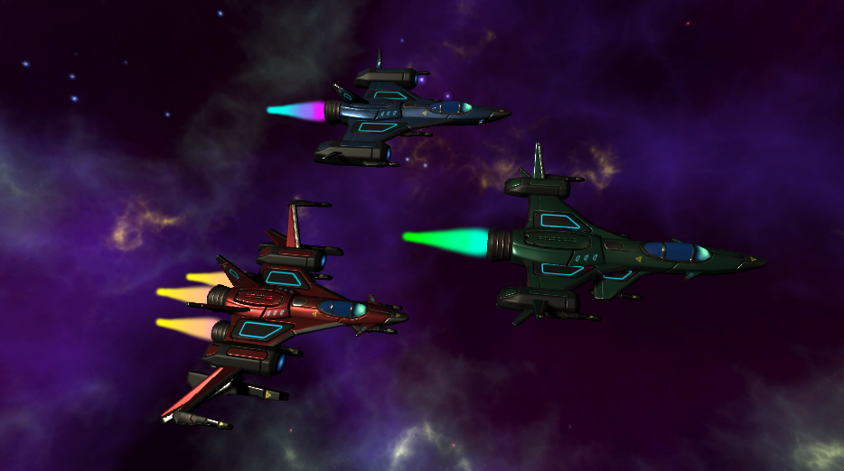
Share with augmented reality
Transform your cards in real ships
Watch your powerful fleet with your phone
Use the Star commanders app to resolve the fight
Replay your most epic battles in 3D and share it with your friends

Slide 4
Let’s play !

